Slide 1
Graph AI for Cybersecurity
Dr. Yuede Ji
Assistant Professor
CSE Department @ UNT
Notes:
Thank you for the introduction.
Good afternoon everyone. Today, I'm glad to share our work on Graph AI for Cybersecurity.

Slide 2
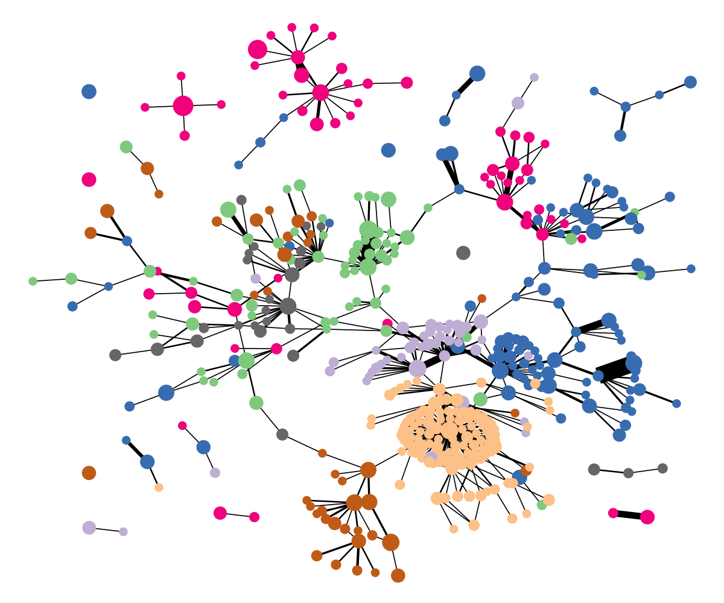
What is Graph?
A graph is a data structure which contains nodes and edges.
An attributed graph is a graph with extra attributes, such as node attributes.
Mernyei, P. and Cangea, C., “Wiki-CS: A Wikipedia-Based Benchmark for Graph Neural Networks”, arXiv e-prints, 2020.
Notes:
A graph is a data structure which contains nodes and edges.
An attributed graph is a graph with extra attributes, such as node attributes.

Slide 3
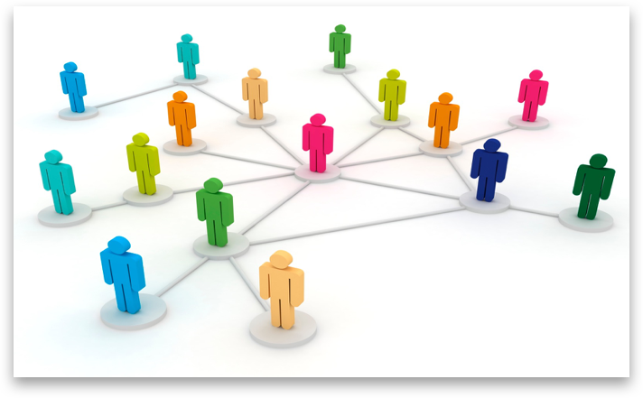
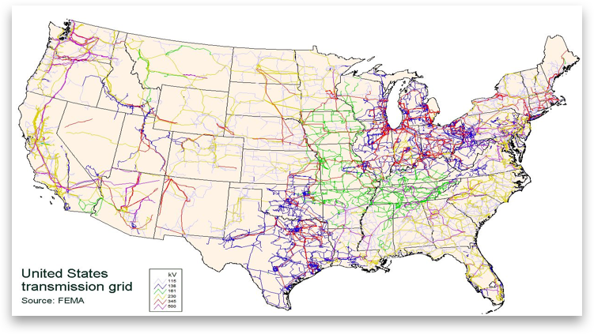
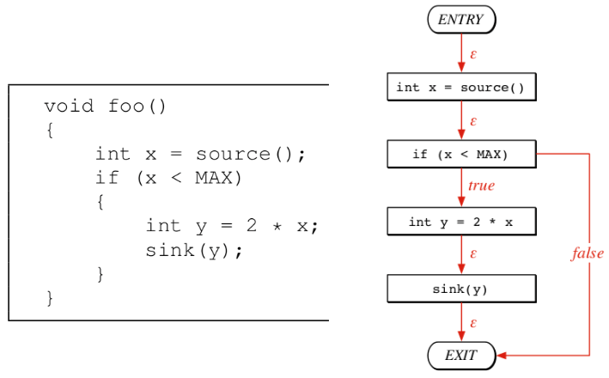
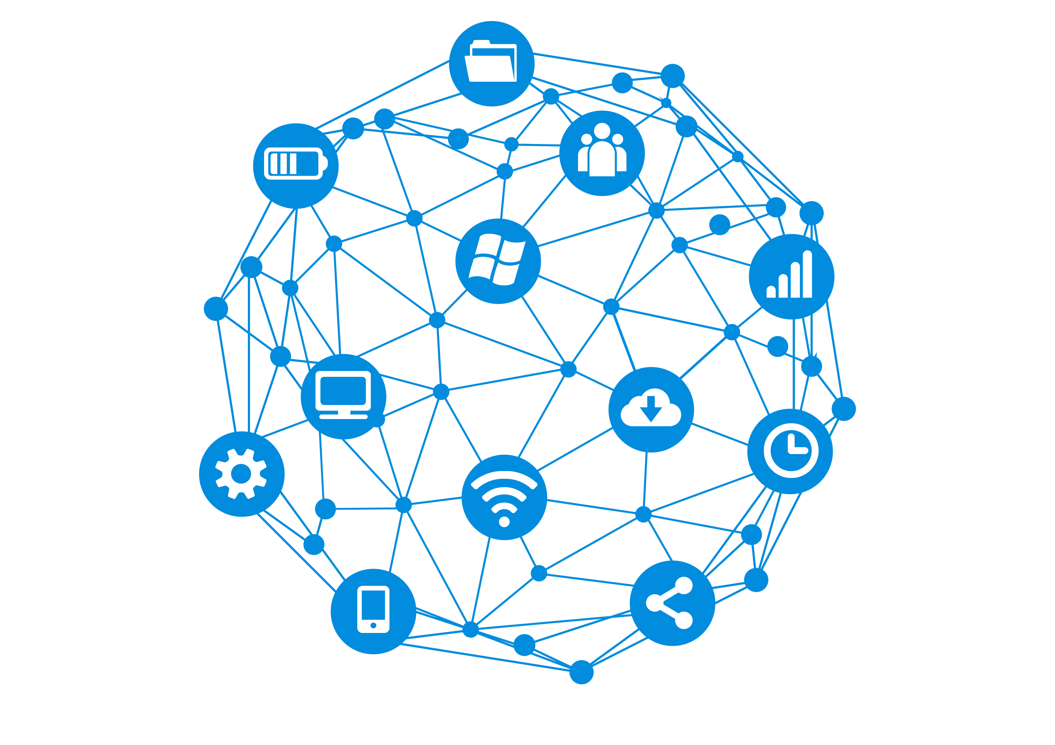
Graph is Everywhere
Notes:
Graph is a natural representation for many real-world applications.
For example, in the social network, every person is a vertex, the connection between two persons is an edge.
Graphs can also be found in many other applications, such as road map, code graphs, and internet communication networks.

Slide 4
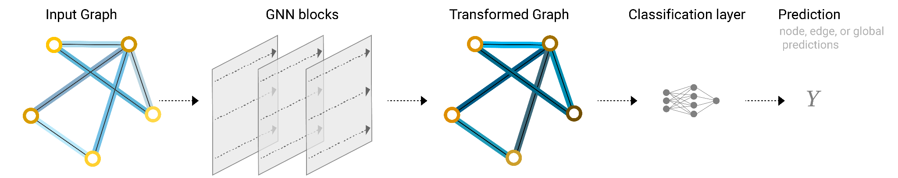
Graph Neural Networks (GNNs)
Sanchez-Lengeling, et al., "A Gentle Introduction to Graph Neural Networks", Distill, 2021.
Notes:
GNNs are a machine learning model working on graph structures. Here, we introduce the fundamental GNN models. It takes an attributed graph as input, generates new node embeddings for different task purposes.

Slide 5
Graph Neural Networks (GNNs)
Sanchez-Lengeling, et al., "A Gentle Introduction to Graph Neural Networks", Distill, 2021.
Notes:
GNNs are a machine learning model working on graph structures. Here, we introduce the fundamental GNN models. It takes an attributed graph as input, generates new node embeddings for different tasks.
It can be used for various tasks, such as, node predictions, edge predictions and global predictions (aka graph predictions).

Slide 6
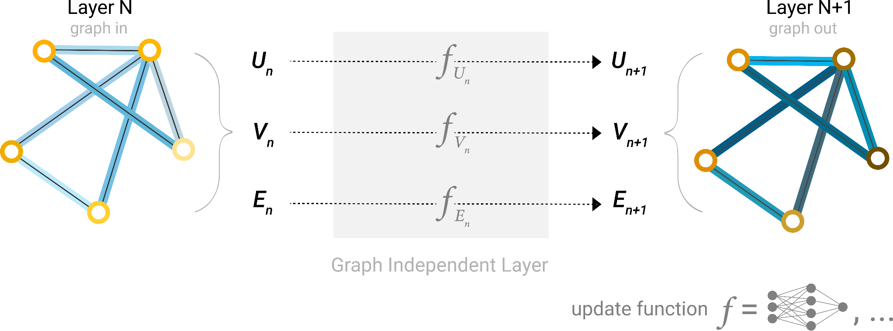
Graph Neural Networks (GNNs)
Sanchez-Lengeling, et al., "A Gentle Introduction to Graph Neural Networks", Distill, 2021.
Notes:
GNNs are multi-layer networks. In each layer, it passes the node embeddings through the edges to the neighboring nodes. Then the received embeddings of one node are aggregated and updated to be the new node embeddings for the next layer.

Slide 7
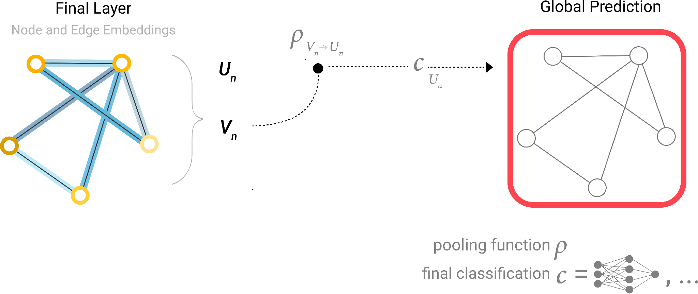
Graph Neural Networks (GNNs)
Sanchez-Lengeling, et al., "A Gentle Introduction to Graph Neural Networks", Distill, 2021.
Notes:
Based on the task, the updated node embeddings are used for training and prediction.

Slide 8

Applying Graph to Cybersecurity
Research Questions:
Q1: How to formalize the cybersecurity problem to a graph problem?
Q2: How to effectively and efficiently solve the graph problem?
Domain | Project | Graph | Graph Algorithms
Code Vulnerability Detection | Illuminati [EuroS&P’22] | Control + Data Flow Graph | Graph Neural Network
Code Vulnerability Detection | DEFInit [USENIX Security’21] | Dependency + Control Flow Graph | Graph Traversal
 | BugGraph [AsiaCCS’21] | Control Flow Graph | Graph Triplet-Loss Network
 | Vestige [ACNS’21] | Function Call Graph | Graph Attention Network
Notes:
We try to apply graph techniques to various cybersecurity applications. To achieve that, we aim to answer two research questions.
The first one is How to formalize the cybersecurity problem to a graph problem?
The second one is How to effectively and efficiently solve the graph problem?
With that, we deeply studied the code vulnerability detection problem. We have built four systems with graph and graph algorithms.
The first one is Illuminati, it detects source code vulnerability by using control flow graph and data flow graph. We used graph neural networks.
The second one is DEFInit, it scans Android firmware and identifies potential vulnerabilities related to system services. We built dependency graph and control flow graph.
The third one is BugGraph, it detects binary code vulnerability by building control flow graphs and applying graph triplet-loss network.
The fourth one is Vestige, it identifies binary code compilation provenance by building function call graph and applying graph attention network.

Slide 9
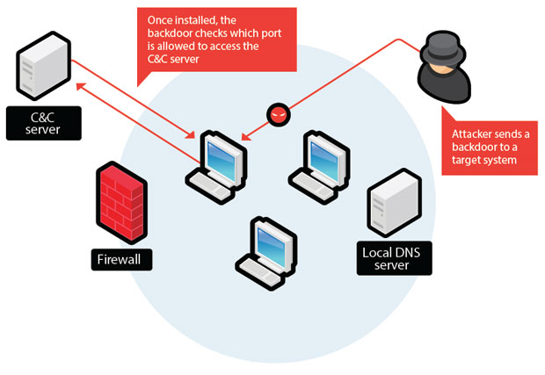
Applying Graph to Cybersecurity
Research Questions:
Q1: How to formalize the cybersecurity problem to a graph problem?
Q2: How to effectively and efficiently solve the graph problem?
Domain | Project | Graph | Graph Algorithms
Code Vulnerability Detection | Illuminati [EuroS&P’22] | Control + Data Flow Graph | Graph Neural Network
Code Vulnerability Detection | DEFInit [USENIX Security’21] | Dependency + Control Flow Graph | Graph Traversal
 | BugGraph [AsiaCCS’21] | Control Flow Graph | Graph Triplet-Loss Network
 | Vestige [ACNS’21] | Function Call Graph | Graph Attention Network
Network Threat Detection | Malicious Host Detection [ICC’22] | Host Communication + Process Alive Graph | NestedGNN (Our Proposed Method)
 | Lateral Movement Detection [RAID’20] | Authentication Graph | Unsupervised Node Embedding
 | Malicious URL Detection [NPC’14 Best Paper] | Social Network User Graph | Local Clustering Coefficient
Notes:
In the meantime, we have also applied graph algorithms to network threat detection. So far, we have studied malicious host detection and lateral movement detection in Enterprise network, and malicious URL detection in social network.
In the following, I will deeply explain our efforts on code vulnerability detection by discussing BugGraph.

Slide 10

Graph for Code Vulnerability Detection
BugGraph: Differentiating Source-Binary Code Similarity with Graph Triplet-Loss Network
Domain | Project | Graph | Graph Algorithms
Code Vulnerability Detection | BugGraph [AsiaCCS’21] | Control Flow Graph | Graph Triplet-Loss Network
Notes:
In this part, I will present how to apply graph and graph algorithms to binary code vulnerability detection.

Slide 11
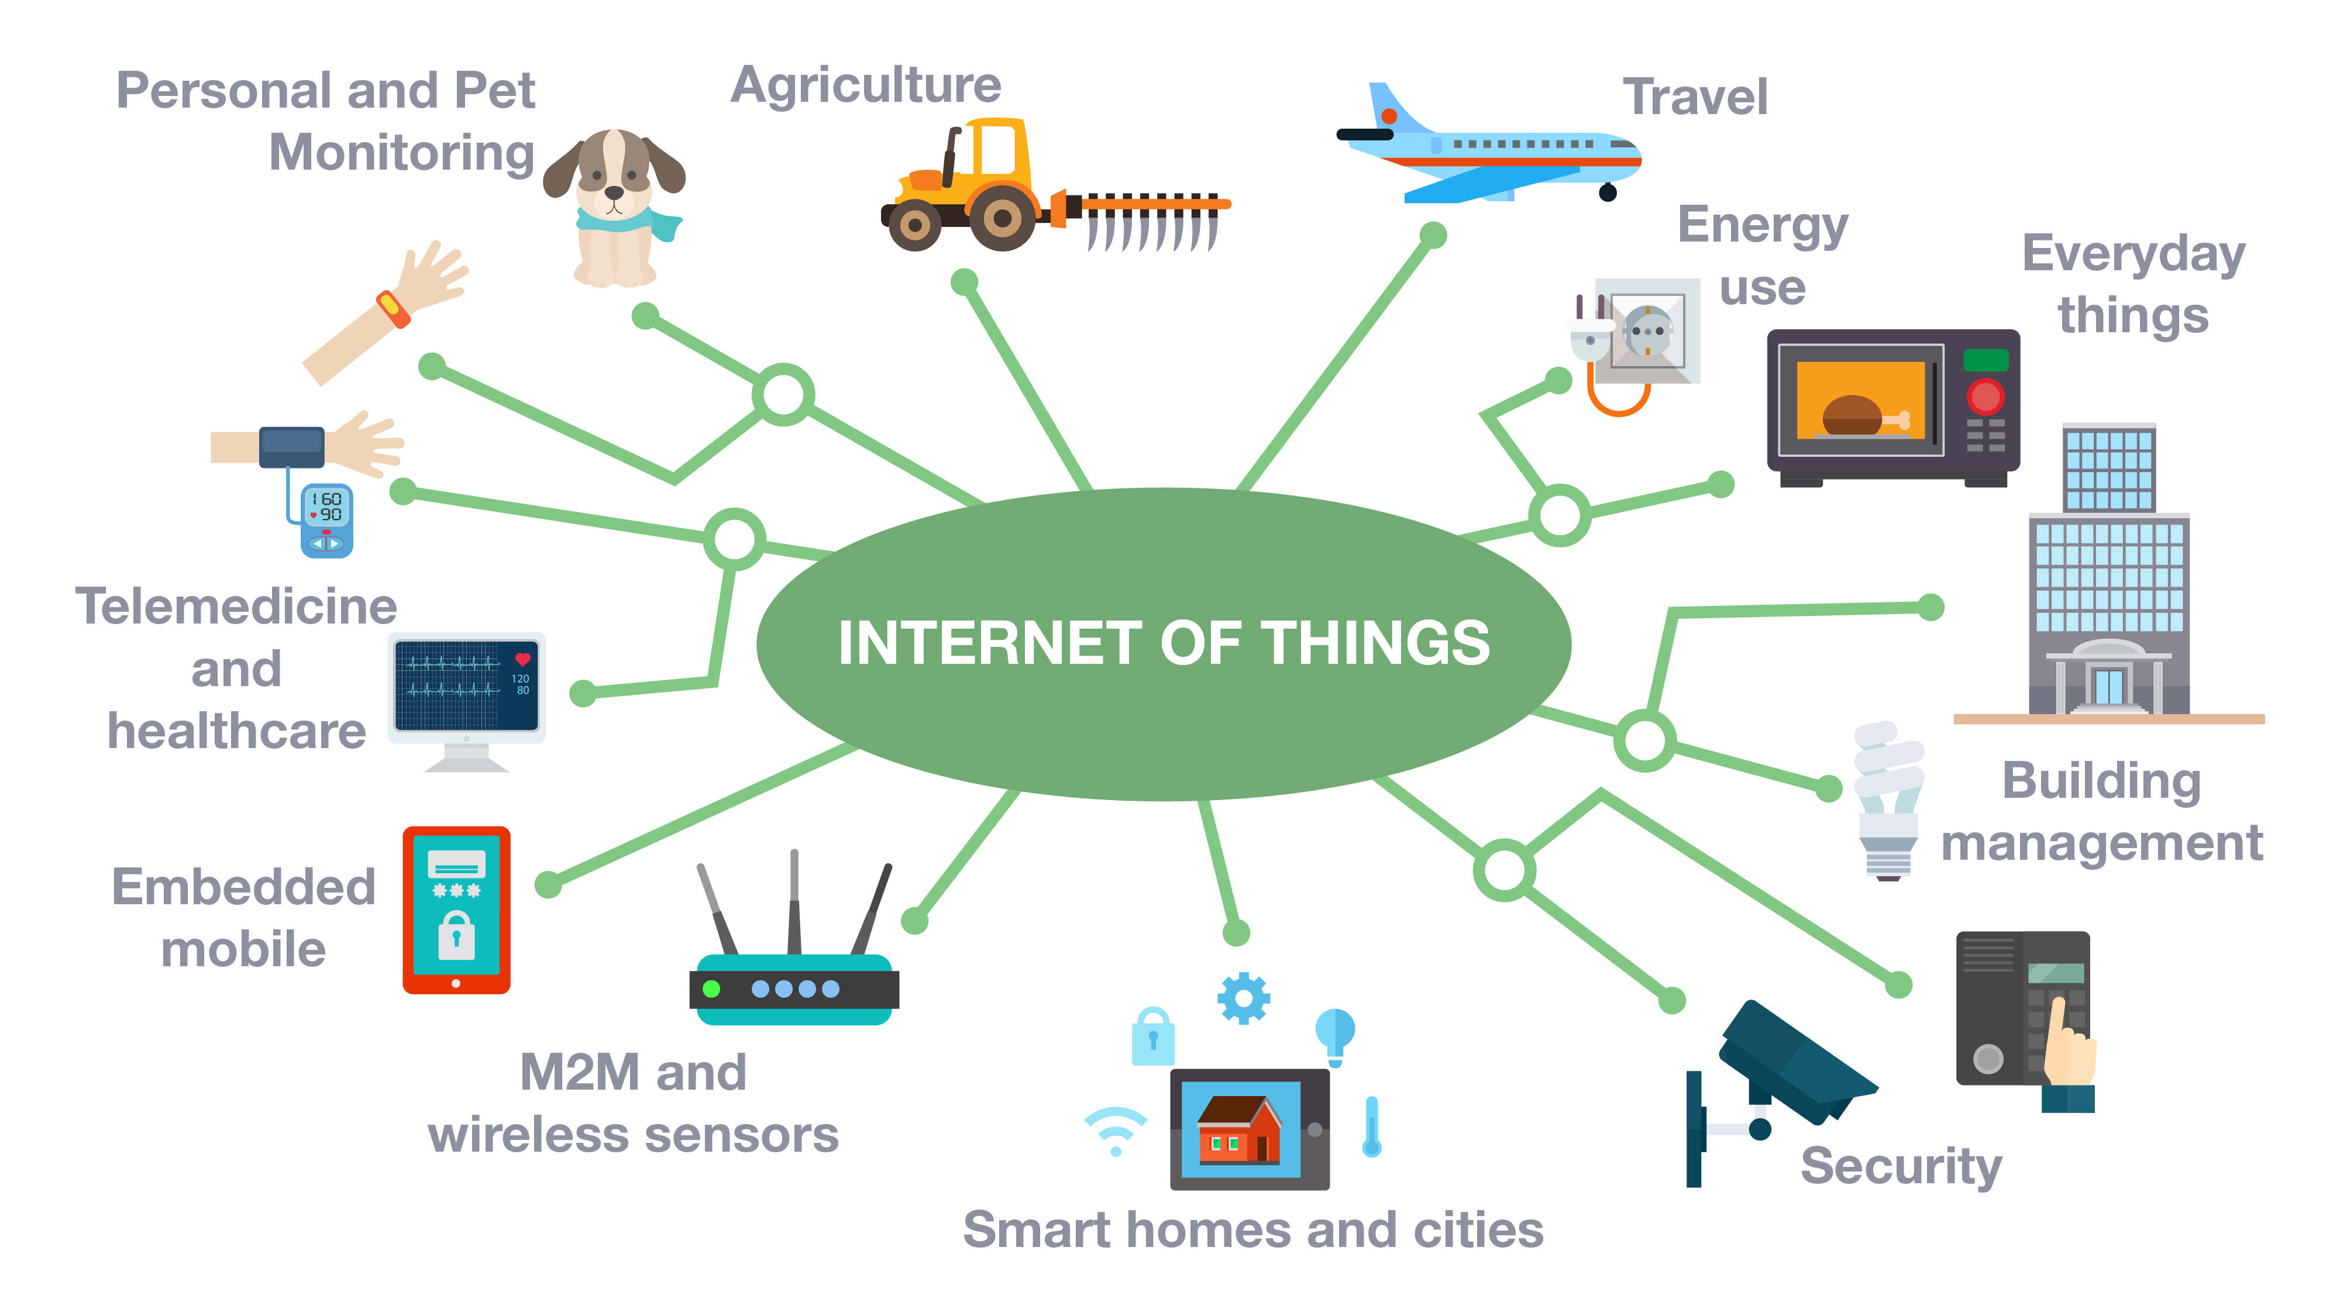
Binary Code is Prevalent
Software vendors usually do not share the source code.
A significant number of binaries are running in the wild, e.g., firmware of IoT devices.
Num. of Connected IoT Devices from 2015 to 2025
Count in billion
75 Billion
31 Billion
11
source: statista
Notes:
Binary code is prevalent as the software vendors usually do not share the source code.
A significant number of binaries are running in the wild, e.g., the firmware of IoT devices.
This figure shows the Num. of Connected IoT Devices from 2015 to 2025. The x-axis shows the year, and y-axis shows the count in billion.
By last year, it has reached 31 billion.
And it is estimated to reach 75 billion by 2025.

Slide 12
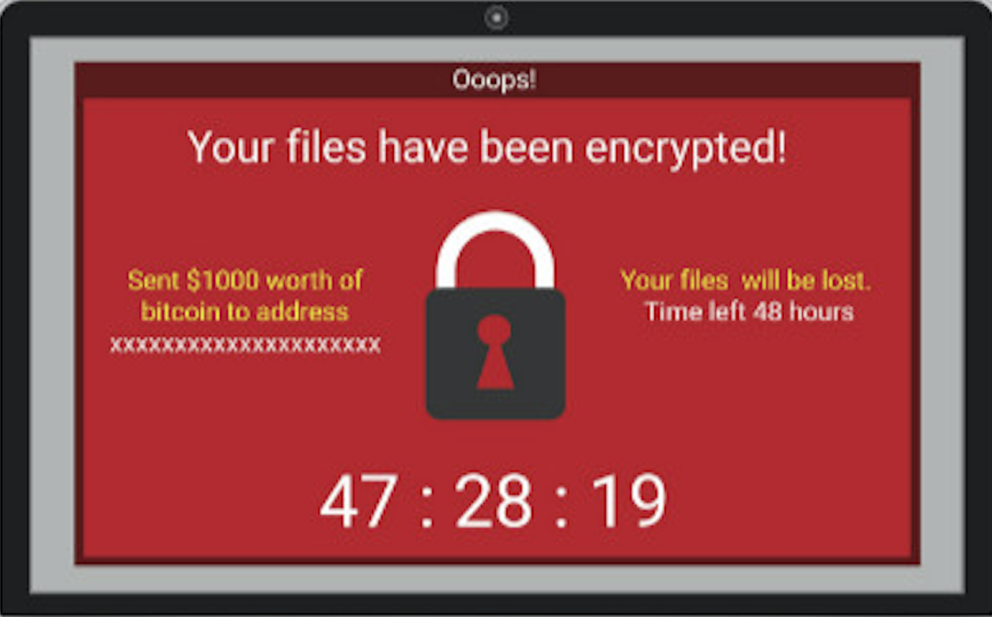
What is Vulnerability?
A vulnerability is a weakness (usually a bug) that can be exploited by the attacker to perform unauthorized activities.
Real-world impact
WannaCry ransomware infects 200,000 computers across 150 countries.
Exploits CVE-2017-0144 vulnerability in Windows’ Sever Message Block protocol.
Integer overflow
Notes:
So, what is a vulnerability?
A vulnerability is a weakness (usually a bug) that can be exploited by the attacker to perform unauthorized activities.
This is an example code of square sum. It looks good. But if you look closely,
at line 7, the value of result could exceed the limit of 32-bit integer.
This would cause an integer overflow vulnerability, which can further be exploited to cause other serious security issues.
You might still remember the WannaCry ransomware. It infects 200,000 computers across 150 countries.
It actually exploits a vulnerability in Windows’ Sever Message Block protocol.

Slide 13
Research Problem
Motivation
Open-source libraries are widely used in binaries, e.g., OpenSSL.
Up to 80% of the binaries in IoT firmware still use third-party libraries with already discovered vulnerabilities.
Research Problem
How to scalably check whether the already discovered vulnerabilities (source code) still exist in the unknow binary code.
[NDSS’13] Cui, Ang, Michael Costello, and Salvatore Stolfo. "When firmware modifications attack: A case study of embedded exploitation." (2013). In NDSS.
Notes:
Although the binary code is closed source, the open-source libraries are widely used in binaries, e.g., OpenSSL.
And up to 80% of the binaries in IoT firmware still use third-party libraries with already discovered vulnerabilities.
So, the research problem we are focusing on is how to scalably check whether the already discovered vulnerabilities still exist in the unknown binary code.

Slide 14
Similarity-Based Solution
Source-Binary Code Similarity for Vulnerability Detection
If an unknown code is similar to a discovered vulnerability template, then the unknown code is potentially to have the same vulnerability.
Challenge:
The source and binary code are not in a canonicalized form.
Existing Solution:
Transform the problem to binary code similarity detection by compiling the source code to a binary.
101010011100000001010010100011001010101010010101010101001010100101010100
101010011100000001010010100011001010101010010101010101001010100101010100
Similar?
Unknown binary code
Vulnerability template
Notes:
An efficient type of solutions is similarity-based.
It is motivated by the observation, that If an unknown code is similar to a discovered vulnerability code, then the unknown code is potentially to have the same vulnerability.
With that, the problem of vulnerability detection has become the problem of source-binary code similarity detection.
It is challenging to directly compare the source and binary code because they are not in a canonicalized form.
To solve that, the previous works would compile the source code to a binary, usually with a randomly picked compilation option.
And then, the problem becomes binary code similarity detection.
However, this kind of solutions face two major challenges.

Slide 15
Challenge #1: Low Accuracy
Low accuracy due to many combinations of compiling options
Compiler: GCC (204 versions), LLVM (55 versions), etc.
Optimization level: O-{0, 1, 2, 3, s, fast, g}
Architecture: x86, ARM, MIPS, etc.
Source code
Front end
Middle end
Back end
Binary code
Lexical analysis
IR analysis
Machine
dependent
optimization
Intermediate Representation
(IR)
111010001100
int f(){
...
Optimized IR
BIN
SRC
Syntax analysis
Machine
independent
optimization
Semantic analysis
Code generation
Compiler (family, version)
Optimization level
Architecture
Notes:
The first challenge is low accuracy due to many combinations of compiling options.
Let’s look at how the binary code is generated. Given the source code, a compiler would apply front end analysis and generate the compiler specific intermediate representation. Next, it will apply middle end analysis and optimize the intermediate representation. Later, it will use back-end analysis and generate machine-specific binary code.
So, in this process, the compiler, optimization level, and architecture would all affect how the binary code is generated.
There are so many combinations of compiling options, for example, the GCC compiler has over 200 versions and the LLVM compiler has 55 versions.
And each compiler version has at least four optimization levels.
Also, there are various architectures, including x86, ARM, MIPs, and others. So, two randomly picked binary codes could have very different compiling options. And this would dramatically lower the accuracy.

Slide 16
Challenge #1: Low Accuracy
Low accuracy due to many combinations of compiling options
Compiler: GCC (204 versions), LLVM (55 versions), etc.
Optimization level: O-{0, 1, 2, 3, s, fast, g}
Architecture: x86, ARM, MIPS, etc.
lea ecx, [rdi-1]
mov edx, ecx
shr edx, 2
lea esi, ds:0[rdx*4]
test esi, esi
jz loc_4007F8
x86-LLVM-3.3-O1
Example source code
x64-GCC-4.8.5-O3
Notes:
Let me explain why with the square sum function example.
using compiler LLVM-3.3 with optimization level O1 on x86 architecture, we will get a disassembled binary code with its control flow like this.
But if we use GCC-4.8.5 with optimization level O3 on x64 architecture, we will get a disassembled binary code like this. The assembly codes are ignored because the code size is too big.
In this case, both the code size and control flows are greatly changed,
mainly because the optimization level O3 applies loop related optimization techniques, such as, loop unrolling and tree vectorization.
It is quite challenging to find these two disassembly codes similar no matter from instructions or code structures.

Slide 17
Challenge #2: Low Coverage of Similar Code Types
Three types of similar code
Type-1: Difference in the white space, blank line, layout, and comment.
Type-2: Difference in identifiers, literals, and data types.
Type-3: Difference in statements, including changed, added, or deleted.
Low coverage as prior works only focus on Type-1/2 similar code
Type-3 contributed to over 50% of all vulnerabilities discovered by code similarity [Islam et al. ESEM’17]
Example source code
Type-1
Type-2
Type-3
Notes:
The second challenge is from the source code level. There are three types of similar code.
By definition, type-1 has Difference in the white space, blank line, layout, and comment.
type-2 has difference in identifiers, literals, and data types.
type-3 has difference in statements, including changed, added, or deleted.
Existing works only focus on type-1/2 similar code, but the type-3 similar code actually contributed to over 50% of all vulnerabilities discovered by code similarity methods.
The type-3 similar code is challenging because it could change the code structure and instructions.
For example, this if statement would create a different control flow and introduced new instructions.

Slide 18
Overview of BugGraph
BugGraph: a two-step source-binary code similarity detection system
Step 1: Source binary canonicalization
First work to identify compilation provenance for source-binary code similarity detection.
Step 2: Code similarity computation
Ranking-based graph triplet-loss network to better detect type-3 similar code.
Notes:
To address these challenges, I design BugGraph, a two-step source-binary code similarity detection system.
The first step addresses the challenge of comparing binaries with different compilation options. It is the first work to identify compilation provenance for source-binary code similarity detection.
Then, we compile the source code to a binary with the same compilation options. To this end, the inputs of source-binary codes become two binary codes with the same compilation options.
In the second step, we convert the binary code to attributed control flow graph,
and design a ranking-based graph triplet-loss network to compute code similarity. This method can significantly improve the accuracy, especially for the challenging type-3 similar code.
Next, I will explain the details of the two steps.

Slide 19

Step 1: Source Binary Canonicalization
Key Insight:
Provenance-guided source binary canonicalization
Compilation Provenance
<architecture, compiler family, compiler version, optimization level>
Idiom feature extraction
I1: mov rax, MEM
I2: mov MEM, rax
{I1: 0.5, G1: 0.3, …}
…
Disassembly
tool
Build attributed function call graph
{I1: 0.1, I2: 0.2, …}
{I2: 0.8, G2: 0.9, …}
Attention-based Graph Neural Network
1010100111
BIN
Graphlet feature extraction
…
G1
G2
Provenance
FCG construction
{I2: 0.6, G1: 0.7, …}
{I1: 0.2, I2: 0.4, …}
Notes:
The key insight of our first step is to use the compilation provenance to guide the canonicalization of source-binary code.
Here, the compilation provenance is regarded as the four major affecters during the compilation process.
They are architecture, compiler family, compiler version, and optimization level.
Given a binary, we first disassemble it to assembly code.
Later, we extract three types of features, the idiom features, the graphlet features on the control flow graph, and the function call graph.
With these features, we build a new representation, named attributed function call graph (AFCG).
Next, we build a provenance prediction model with an attention-based graph neural network.

Slide 20
Compilation Provenance Identification
Source code fragment of CVE-2015-1792
Provenance 1: x86-GCC-4.8.4-O2
Provenance 2: x86-LLVM-5.0-O0
Idiom features
Graphlet features
Function call graph
Notes:
Now, let’s look at the features.
I will use this source code fragment from a real vulnerability as an example.
Here is the assembly code with compilation provenance x86-gcc-4.8.4-O2,
And this is the assembly code with a different provenance.
First, we extract the idiom features from the instruction level because different compilers usually have different rules for instruction, register, and instruction ordering.
For example, for this line of source code, the first provenance uses one mov instruction and base address register ebx. But the second provenance uses two mov instructions, and base register eax. So, to capture these differences, we first normalize the operands, such as memory address, constants, and function name. Then, we extract the unique instruction patterns and their combinations as the instruction features.
The second type of feature is graphlet feature. Different compilation provenances have different rules on how the basic blocks form the control flow graph. In this example, the first compilation provenance generates 2 nodes, but the second provenance only generates 1 node. To capture these differences, we extract graphlet features. First, we normalize the control flow graph by assigning a type value to each node and edge based on the instructions. Then we mine the graph patterns as the feature.
The third type of feature is function call graph. Many compiler optimizations work on the binary level, such as, function inlining, procedure reordering, and interprocedural dead code elimination. So, we use the function call graph to capture these differences. Combining them together, we build an attributed function call graph.

Slide 21
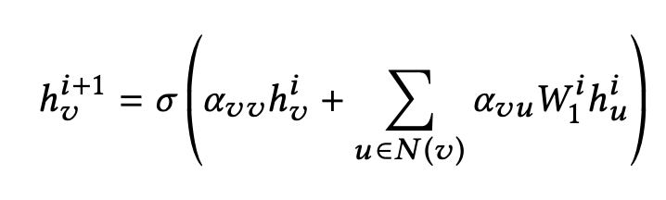

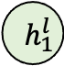
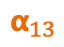
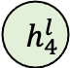
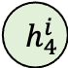
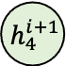
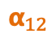
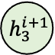
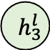
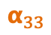
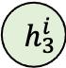
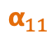
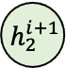
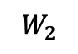
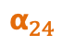
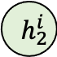
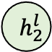

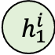
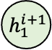
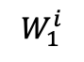
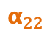
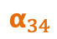
Attributed Graph Embedding
Graph Embedding
Graph attention network (GAT) [Veličković et al. ICLR’18]
Node embedding:
$$W_{1}^{i}$$
$$W_{2}$$
$$h_{1}^{i}$$
$$α_{11}$$
$$h_{1}^{i+1}$$
$$h_{1}^{l}$$
$$h_{1}$$
$$α_{12}$$
$$h_{2}^{i}$$
$$α_{22}$$
$$α_{13}$$
$$h_{2}^{i+1}$$
$$h_{2}^{l}$$
$$h_{2}$$
$$h_{3}$$
$$α_{24}$$
…
$$e_{j}$$
$$h_{3}^{i}$$
$$α_{33}$$
$$h_{3}^{i+1}$$
$$h_{3}^{l}$$
$$α_{34}$$
$$h_{4}$$
$$h_{4}^{i}$$
$$h_{4}^{i+1}$$
$$h_{4}^{l}$$
$$α_{44}$$
Input
i-th
(i+1)-th
l-th
Output
Label
Notes:
With the attributed graph, we build a provenance identification model with the graph embedding method.
We use an attention-based graph neural network, named graph attention network.
Given an input graph with node attribute,
The graph attention network would iteratively update a node’s embedding by accumulating the embeddings of its neighbor and itself from the previous layer.
In the end, graph attention network would accumulate the node embeddings to generate a graph embedding. Based on the label, we compute the loss value and back propagate to optimize the network.
To this end, we build a provenance identification model. Once we identify the compilation provenance, we would compile the source code with the same provenance.

Slide 22
Step 2: Code Similarity Computation
Key Insight:
Represent binary code with attributed control flow graph.
Use ranking-based graph triplet-loss network to identify different types of similar code.
Notes:
Then the problem becomes binary code similarity detection.
The first step handles the difference from compilers. In this step, we mainly need to worry about how to identify the binaries with similar source code.
So, we first represent the binary code with attributed control flow graph.
Later, we use ranking-based graph triplet-loss network to identify different types of similar code.

Slide 23
Binary Code to Attributed Graph
Attributed control flow graph
Control flow graph: essential code structure feature
Attributes: syntax features
The problem has become attributed graph similarity problem.
Label ?
int __cdecl do_free_upto(void *, int)
...
jz short loc_81A85E6
Instruction | # of numeric constants
 | # of string constants
 | # of transfer instructions
 | # of calls
 | # of arithmetic instructions
 | # of instructions
Structure | # of children
 | Betweenness centrality
{2, 0, 1, 0, 3, 1, 2, 0}
...
jnz short loc_81A85B6
...
call BIO_free_all
{0, 0, 3, 2, 12, 0, 2, 0.083}
{0, 0, 1, 1, 3, 0, 0, 1, 0.083}
jmp short loc_81A85F2
{0, 0, 1, 0, 1, 0, 1, 0.083}
...
do_free_upto endp
{1, 0, 0, 0, 2, 1, 0, 0}
Assembly code of CVE-2015-1792 compiled with x86-GCC-4.8.4-O0
[CCS’16] Qian Feng, Rundong Zhou, Chengcheng Xu, Yao Cheng, Brian Testa, and Heng Yin. 2016. Scalable Graph-based Bug Search for Firmware Images. In CCS 2016.
Notes:
The control flow graph reserves the code structure, it is an essential representation for code analysis.
For example, this figure shows the Assembly code of a vulnerable binary code. But, only using the control flow graph is not enough because two different codes might share quite similar control flows.
So, we attribute each vertex with syntax features. In total, we extract 8 features, including 6 instruction and 2 structure features. The instruction features include the numeric constants, string constants, transfer instructions, calls, arithmetic instructions, and total instructions. The structure features include the number of children and betweenness centrality value on the control flow graph.
With that, the binary code is converted to an attributed graph.
Now, the code similarity problem has become the attributed graph similarity problem.
We also use graph embedding method, but there is one problem. We don’t have a label for each code.

Slide 24
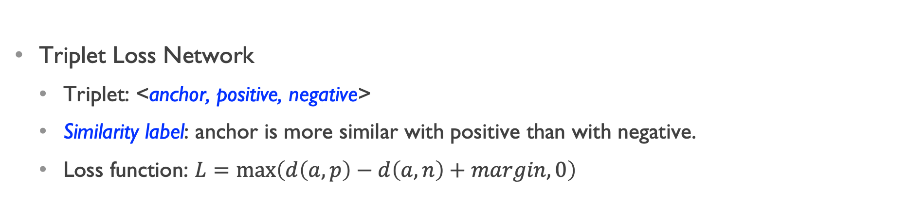
Ranking-Based Triplet Loss Network
Triplet Loss Network
Triplet: <anchor, positive, negative>
Similarity label: anchor is more similar with positive than with negative.
Loss function: $L=\max\left(d\left(a, p\right)−d\left(a, n\right)+margin, 0\right)$
Positive
Positive
Anchor
Anchor
Learning
Negative
Negative
Notes:
So, to solve this label problem, we use a Ranking-Based Triplet Loss Network.
a triplet includes anchor, positive, and negative elements.
The label is on the triplet, not on each element. Basically, the label means the anchor is more similar with the positive than with the negative.
Based on this loss function, the triplet network can generate loss values to supervise the learning process of the graph attention network.
During the learning process, the triplet loss network will learn to put the anchor and positive elements more similar than the anchor and negative elements.

Slide 25
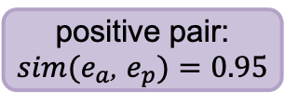
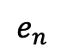
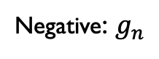
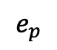
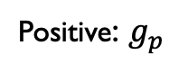
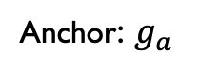
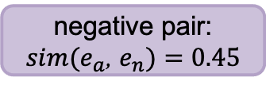
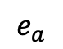
Graph Triplet-Loss Network for Code Similarity
Ranking similar code:
Type-1 > Type-2 > Type-3 > Different
Anchor: $g_{a}$
Positive: $g_{p}$
Negative: $g_{n}$
<1,3,7,0,3,1,0,0>
d
Graph Attention Network
Graph embedding
$$e_{a}$$
$$e_{p}$$
$$e_{n}$$
Triplet Loss
Type-1
positive pair:
$sim(e_{a}$, $e_{p})=0.95$
negative pair:
$sim(e_{a}$, $e_{n})=0.45$
Type-2
Type-3
$L_{i}=max⁡\{sim(e_{a}$, $e_{n})$ - $sim(e_{a}$, $e_{p})+$𝚫, $0\}$
Different
Notes:
Combining them together, we get our graph triplet-loss network.
Taking a triplet of anchor, positive, and negative graphs as input,
the graph attention network generates the graph embedding for each graph.
Then, we use the triplet loss network to compute the loss value.
Next, we back propagate the loss value to the graph attention network and supervise its learning process.
In the end, our graph triplet-loss network would be able to rank different similar code in the high dimensional space like this.

Slide 26
Experiment
 | Software | Compilation Provenance | Similarity Types | # Binaries | # Functions
Train | SNNS-4.2, PostgreSQL-7.2 | Architecture: x86 Compiler: GCC-{4.6.4, 4.8.4, 5.4.1}, LLVM-{3.3, 3.5, 5.0} Optimization: O0 – O3 | Type-1/2/3 | 600 | 493,841
Test | Binutils-{2.25, 2.30}, Coreutils-{8.21, 8.29} |  | Type-1/2/3 | 5,568 | 2,648,627
Total | - | 24 | Type-1/2/3 | 6,168 | 3,142,468
Dataset
6K+ binaries, 3M+ functions
24 compilation provenances
Training and testing use different software
Search 3,000 Type-1/2/3 similar code (1,000 for each)
Report the top-k hit rate, the smaller k the more important
Notes:
Now let’s look at the Experiment.
Here is the dataset we used.
We compiled six software with 24 compilation provenances. That generates over six thousand binaries, and 3 million functions.
The training and testing use different software to avoid the potential bias caused by code sharing in the same software.
We search 3,000 type-1/2/3 similar code.
We report the top-k hit rate, which is the smaller k the more important. Because the security analysists would start investigating from the top. So, the higher we rank the target, the better.

Slide 27
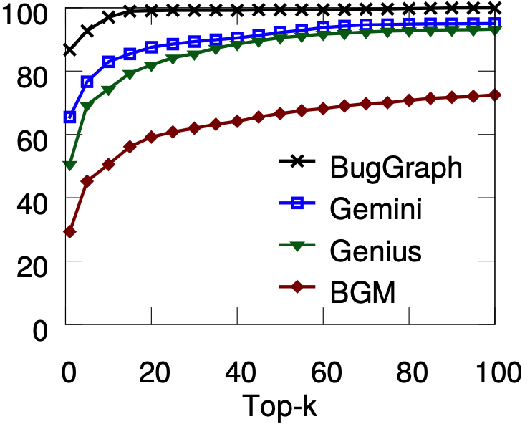
Source-Binary Code Similarity Test
Compilation provenance accuracy:
82% overall accuracy
100%, 100% for architecture, compiler family
96%, 84% for version, and optimization
Type-1 similar code:
E.g., Top-5 hit rate
BugGraph, 93%
Gemini [Xu et al. CCS’17], 77%
Genius [Qian et al. CCS’16], 69%
BGM [Bipartite Graph Matching], 45%
Top-k Hit Rate of Type-1 Similar
Hit rate (%)
Notes:
As for compilation provenance, our method can get 82% overall accuracy.
We get 100% accuracy for architecture and compiler family.
For compiler version and optimization level, we get 96% and 84%.
We compared BugGraph with three works.
Gemini and Genius are two recent works, BGM is a baseline method using bipartite graph matching.
For type-1 similar code, BugGraph gets better result than compared works, especially for smaller k values.

Slide 28
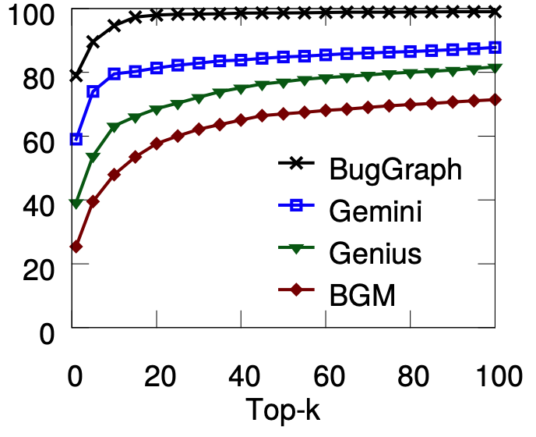
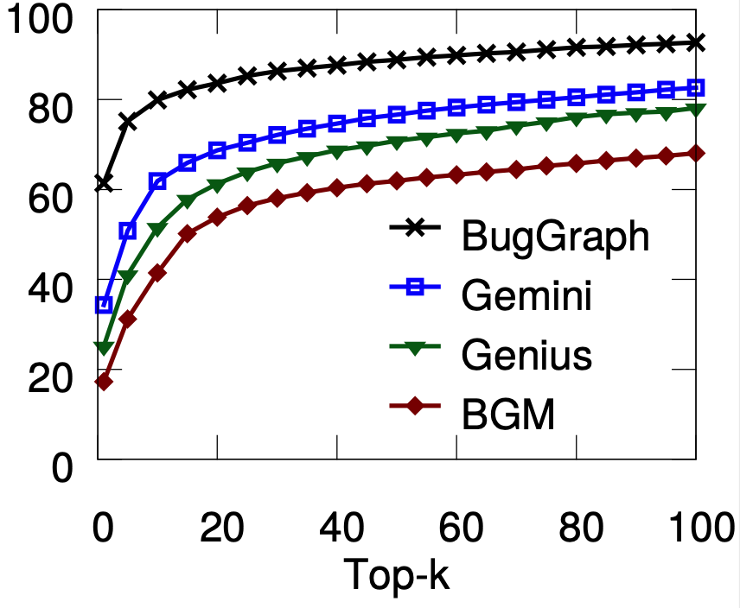
Source-Binary Code Similarity Test
Type-2 Similar Code (top-5 hit rate)
BugGraph, 90%
Gemini, 74%
Genius, 54%
BGM, 40%
Type-3 Similar Code (top-5 hit rate)
BugGraph, 75%
Gemini, 51%
Genius, 41%
BGM, 31%
Top-k Hit Rate of Type-2 Similar
Top-k Hit Rate of Type-3 Similar
Hit rate (%)
Hit rate (%)
Notes:
For type-2 similar code, BugGraph achieves 90% for top-5 hit rate. That is over 16% higher than the rest.
For type-3 similar code, BugGraph achieves 75% for top-5 hit rate. That is over 24% higher than the rest.

Slide 29
Detecting Vulnerabilities from Firmware
Tested firmware: ArcherC9, AD7200, TouchP5, ArcherC2600, ArcherC5200, and ArcherC5400
Vulnerability database: 218 known vulnerable code
Findings:
Identified 140 vulnerable code from 42 unique CVEs.
Old vulnerabilities still exist.
CVE | # Appear | Vulnerability type | CVE | # Appear | Vulnerability type | CVE | # Appear | Vulnerability type
2016-6303 | 5 | out-of-bounds write | 2016-0702 | 5 | side-channel attack | 2015-0206 | 4 | Allow DoS attack
2016-6302 | 5 | Allow DoS attack | 2016-0701 | 2 | Miss required crypto | 2015-0205 | 4 | Allows remote access
2016-2842 | 5 | Out-of-bounds write | 2015-3197 | 3 | Man-in-the-middle | 2015-0204 | 4 | Downgrade attacks
2016-2182 | 5 | Out-of-bounds write | 2015-1794 | 2 | segmentation fault | 2014-8176 | 4 | DoS overflow
2016-2180 | 5 | Out-of-bounds read | 2015-1792 | 4 | Allows DoS attack | 2014-5139 | 3 | NULL pointer dereference
2016-2178 | 5 | Side-channel attack | 2015-1791 | 4 | Double free | 2014-3572 | 4 | Downgrade attacks
2016-2176 | 2 | buffer over-read | 2015-1790 | 4 | NULL pointer dereference | 2014-3567 | 4 | Allow DoS attack
2016-2109 | 2 | memory consumption | 2015-1789 | 4 | Out-of-bounds read | 2014-3511 | 1 | Man-in-the-middle
2016-2105 | 2 | heap memory corruption | 2015-1788 | 4 | Allow DoS attack | 2014-3508 | 1 | information leakage
2016-0799 | 5 | Out-of-bounds read | 2015-0292 | 4 | Integer underflow | 2014-3470 | 1 | NULL pointer dereference
2016-0797 | 3 | Integer overflow | 2015-0288 | 4 | NULL pointer dereference | 2014-0221 | 1 | Allow DoS attack
2016-0705 | 5 | Double free | 2015-0287 | 4 | invalid write operation | 2014-0198 | 1 | NULL pointer dereference
2016-0704 | 4 | Information leakage | 2015-0286 | 4 | invalid read operation | 2014-0195 | 1 | Buffer overflow
2016-0703 | 1 | Man-in-the-middle | 2015-0209 | 4 | Use-after-free | 2013-6449 | 1 | Daemon crash
Notes:
Next, we apply BugGraph to detect the vulnerabilities from real firmware.
We tested six firmware from routers.
We build a vulnerability database with 218 known vulnerable code.
Here are our findings.
We identified 140 vulnerable code from 42 unique vulnerabilities.
This table summarizes the vulnerability, the number of appearances, and vulnerability type
We also find some old vulnerabilities still exist, for example, this one is 8-years-old, and it’s still there.

Slide 30
Summary of Graph for Code Vulnerability Detection
New Insight and Method:
BugGraph, first work to identify compilation provenance for code similarity detection.
Improved both accuracy and coverage for less similar code.
Impact:
BugGraph identified 140 vulnerable code from 6 IoT firmware.
Notes:
In summary,
BugGraph is the first work to identify compilation provenance for code similarity detection. It has significantly improved both accuracy and coverage for less similar code. This project has been reported to the DARPA CHASE program.
DEFInit is the first study on security risks caused by customized Android Init services and actions.
It has been deployed in Kryptowire.
BugGraph Identified 140 vulnerable code from 6 IoT firmware.
DEFInit has discovered 191 new vulnerabilities from 259 Android firmware.

Slide 31

Graph-Centric Security, Learning, and Computing (Graph) Lab @ UNT
Security
Code vulnerability detection
DEFInit [Security’21]
BugGraph [AsiaCCS’21]
Vestige [ACNS’21]
Cyber threat detection
NestedGNN [ICC’22]
CyberGraph [RAID’20]
HPC
Graph Algorithm/Learning
HPC for graph algorithms
Aquila [HPDC’20]
iSpan [SC’18]
GNN explanation for security applications
Illuminati [EuroS&P’22]
HPC for GNN
TLPGNN [HPDC’22]
Notes:
For security, we mainly work on
1. code vulnerability
2. cyber threat detection
For graph algorithms, we also look at the explanation to GNN models, especially for security applications.
For HPC, we mainly work on
1. HPC for GNN
2. HPC for graph algorithms

Slide 32
Acknowledgement to Students @ Graph Lab
Wang Feng (PhD student)
Krishna Sai Ujwal (PhD student)
Boxiang Guo (MS student)
Krishna Tiwadi (Undergraduate)
Vedansh Tembhre (Undergraduate)
Avik Malladi (UNT TAMS, High School)
Lillian Wang (UNT TAMS, High School)
Chotepong Victor Tangton (UNT TAMS, High School)
Donavon Zhang (UNT TAMS, High School)
Sua Cho (UNT TAMS, High School)
Notes:
Many thanks to the talented students at our graph lab.

Slide 33







Acknowledgement to Collaborators
Dr. H. Howie Huang
…
Dr. Hang Liu
…
Dr. Angelos Stavrou
Dr. Peng Gao
Dr. Binghui Wang
Dr. Alexandru G. Bardas
…
Dr. Mohamed Elsabagh
Dr. Ryan Johnson
Dr. Pradeep Kumar
…
Notes:
Many thanks to my collaborators.

Slide 34
Graph-Centric Security, Learning, and Computing (Graph) Lab @ UNT
Security
Code vulnerability detection
DEFInit [Security’21]
BugGraph [AsiaCCS’21]
Vestige [ACNS’21]
Cyber threat detection
NestedGNN [ICC’22]
CyberGraph [RAID’20]
HPC
Graph Algorithm/Learning
HPC for graph algorithms
Aquila [HPDC’20]
iSpan [SC’18]
GNN explanation for security applications
Illuminati [EuroS&P’22]
HPC for GNN
TLPGNN [HPDC’22]
Notes:
Thank you for listening.
I would be happy to take your questions now.

